Slide 1
Queryosity Killed the RAG
Smarter Enterprise Search with BigQuery

Slide 2
Contents
1.
Goal
2.
Approach
3.
BigQuery AI/ML
4.
What did I do?
5.
Feedback
6.
What can be done more

Slide 3

Meet the team
Meher Gajula

Slide 4
Let’s change Enterprise Search.

Slide 5
Hackathon roadmap
Goal
Step 1
Step 2
Step 3
Step 4
Data Ingestion
Extraction
Loading into BQ
Agent - BQ Tools
Access Information and More

Slide 6
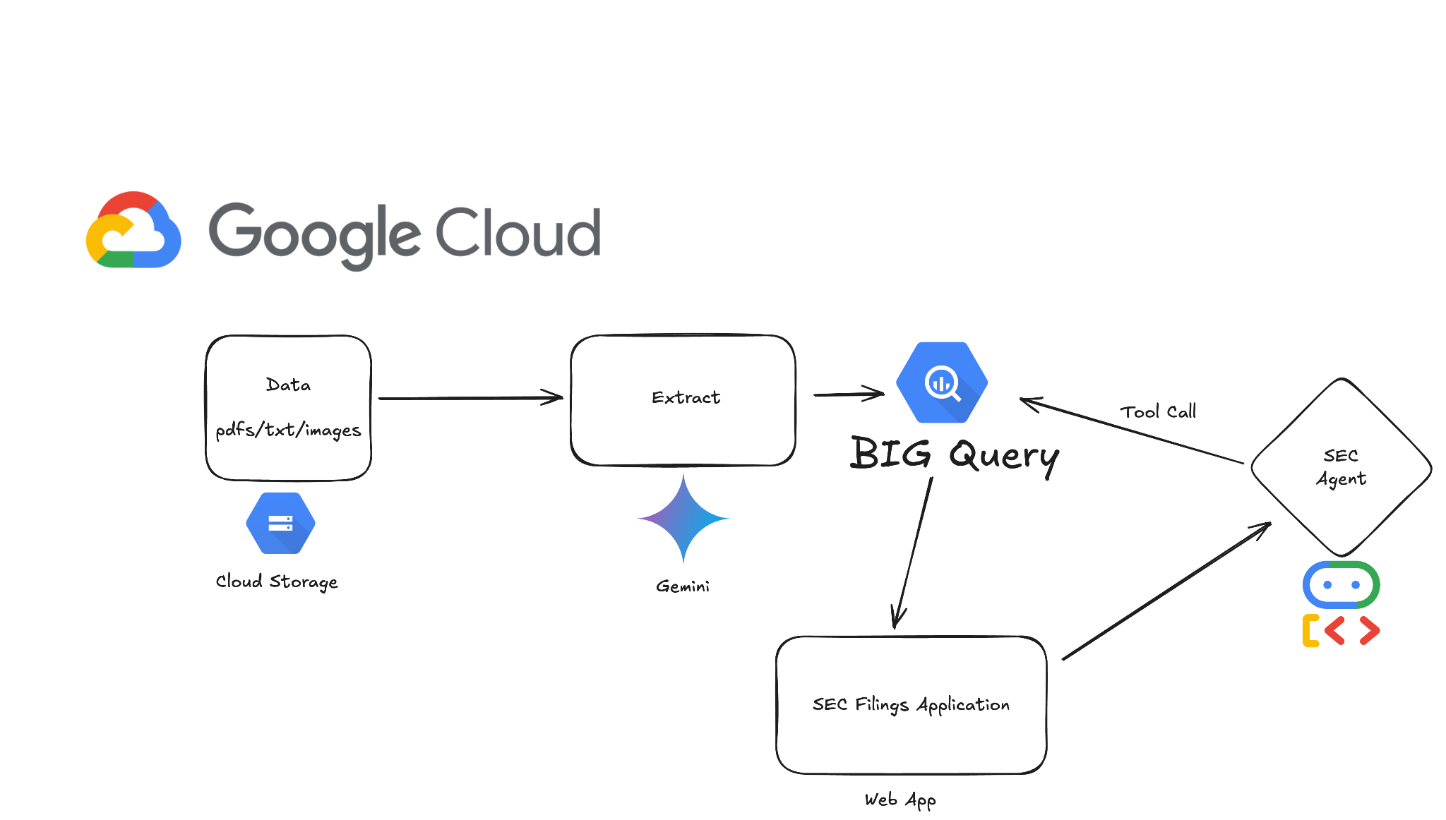

Slide 7
Demo

Slide 8
Thank you

